Slide 1

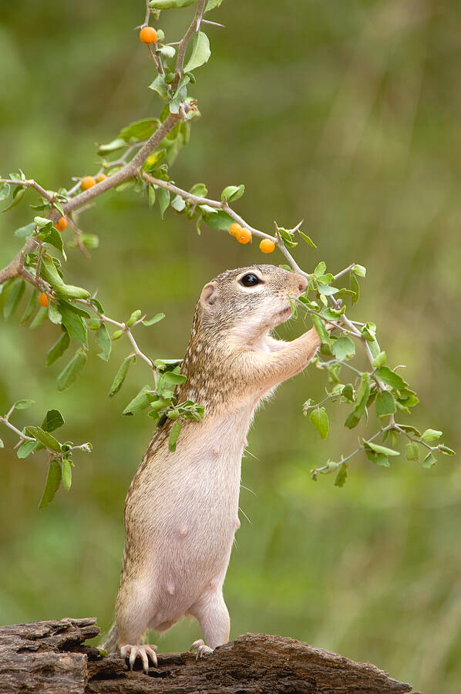
ANIMAL MOVEMENT in Foraging
Model applied
Random Walk
Stat 482 - Chi Nguyen
Mexican Ground Squirrel Foraging For Berries

Slide 2
Background
Animal foraging movement is how animals search for food, balancing exploration and efficiency, often influenced by environmental factors and memory.
Animal foraging movement is often studied using random walk models, which simulate step lengths and turning angles to represent exploratory behavior.
However, animals may not always move randomly - memory can influence their paths, leading to more efficient foraging by revisiting resource-rich areas or avoiding previously explored regions.
This analysis checks if the movement follows a random walk or is influenced by memory, using step lengths, turning angles, and displacement over time.

Slide 3
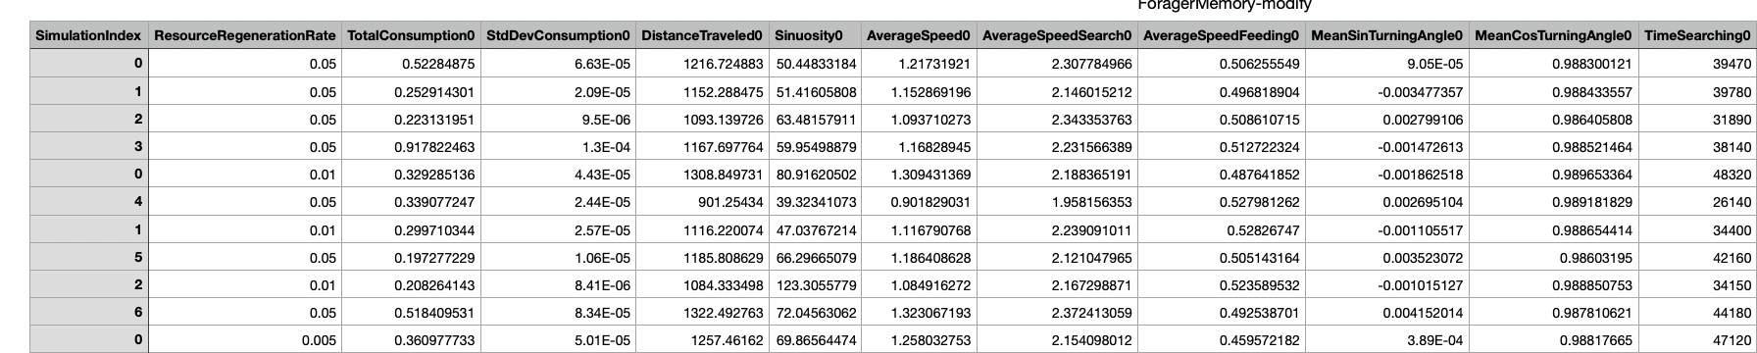
The dataset
The dataset
The dataset, acquired from PLOS ONE (from the article Memory Effects on Movement Behavior in Animal Foraging by Bracis, Gurarie, Van Moorter, and Goodwin (2015)), tracks animal movement during foraging, focusing on step lengths, turning angles, and displacement over time
The key metrics for analysis are:
Turning Angles: Mean Cosine/Sine Turning Angle: Determines directional consistency (goal-oriented vs. random movement).
Distance Traveled: Stepwise and average distances by resource regeneration rate to assess how resource availability impacts movement.
Resource Regeneration Rate: Analyzes the effect of resource availability on foraging behavior.
Dataset

Slide 4
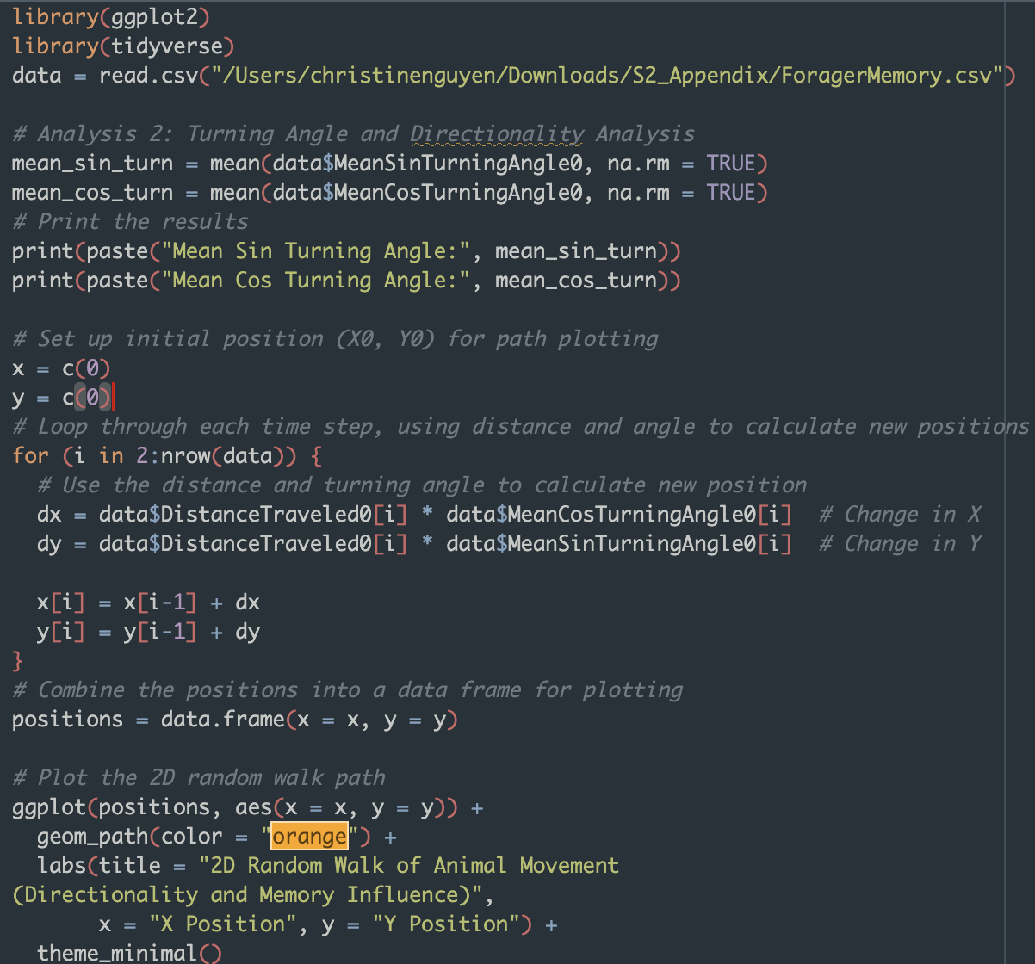
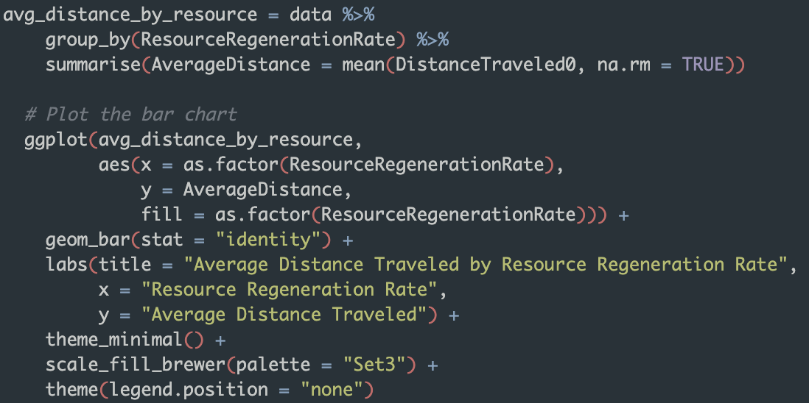
R Code

Slide 5
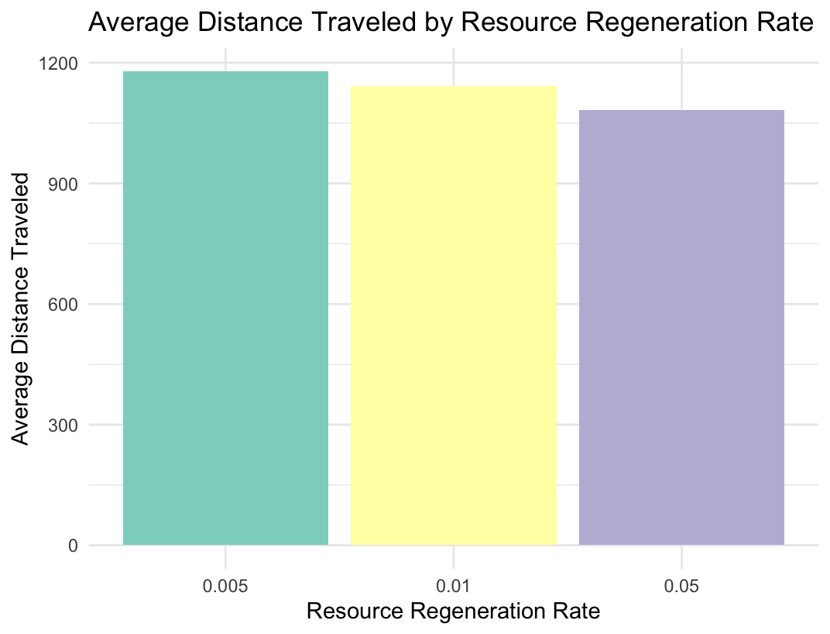
Average Distance Traveled by Resource Regeneration Rate
This chart shows that at low resource regeneration rates (0.005), animals travel the longest, while higher rates (0.01 and 0.05) result in shorter distances.
Inefficient resources require animals to explore further, while faster regeneration allows them to forage more efficiently in localized areas
This reflects how resource availability impacts movement patterns.

Slide 6
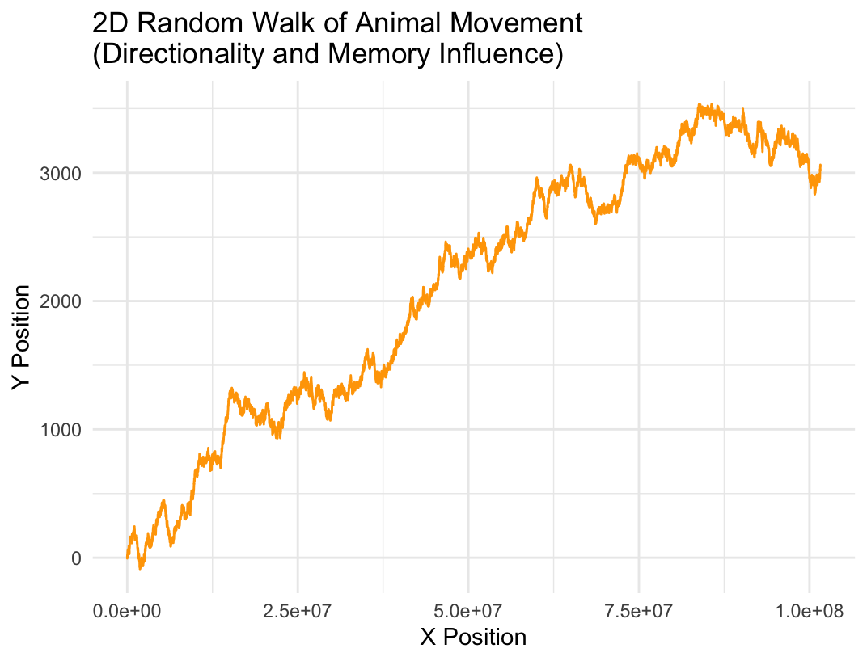
Random Walk of Animal Movement
This graph shows a 2D random walk of animal movement, with a smooth upward trend indicating directional consistency The lack of sharp turns or looping suggests memory-influenced foraging, where the animal avoids redundant paths and balances exploration with goal-oriented movement.

Slide 7
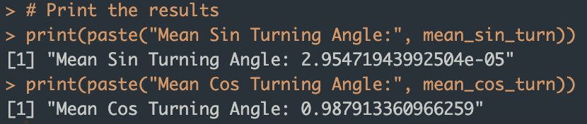
Random Walk of Animal Movement
The turning angle analysis shows
a near-zero mean sine value (2.95e-05), indicating no significant left or right bias
a high mean cosine (0.9879), reflecting strong directional persistence.
The 2D movement graph supports this, showing an upward trajectory with consistent forward motion and a lack of sharp turns.
Combined with the bar chart, the results suggest memory-driven foraging: traveling farther when resources regenerate slowly and staying closer to the source when regeneration is faster.
Conclusion:
This shows that movement is shaped by memory and resource availability instead of being completely random.

Slide 8
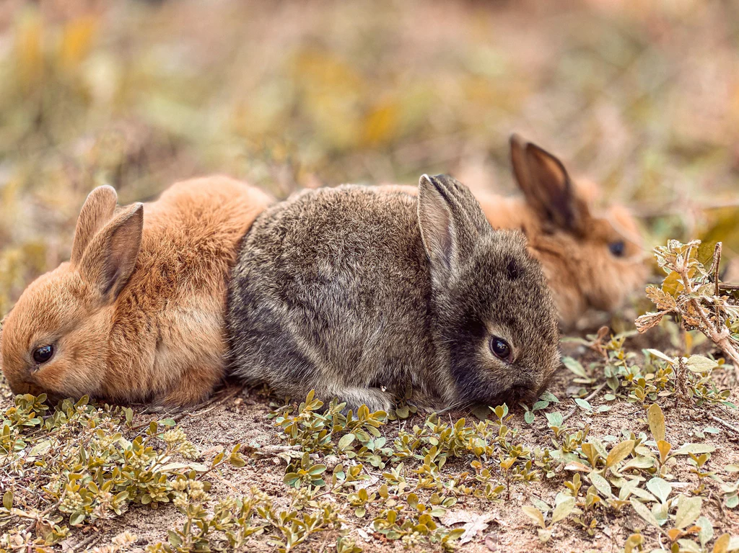
THANKS!
DR.OLGA & STAT 482 CLASSMATES

